Slide 1

Mid semester presentation for Master Thesis Project on CONTACTLESS RADAR-BASED VITAL SIGN MONITORING
Name : Ravishankar Kumar
Reg no. : 2022EEM1007
Under the supervision of
Dr. Brijesh Kumbhani
Department of Electrical Engineering
Indian Institute of Technology ,Ropar

Slide 2
Content
Motivation
Objective
Literature Survey
Model Implemented
Testing Setup
Simulated results
Future work plan
Conclusions

Slide 3
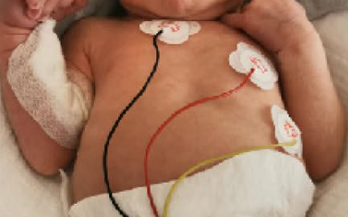
Motivation
Contactless radar-based vital sign monitoring project can fulfill the need for remote, and continuous monitoring of a person's vital signs. Here are several compelling reasons for pursuing such a project:
Patient Comfort and Safety
Continuous Monitoring
Reduced Healthcare Costs
Home Healthcare
Fig.1.Current model to monitor vital sign

Slide 4
Objective
Design a Radar system that can measure the breathe rate of single person without any contact.
Design a Radar system that can measure the breathe rate of multiple person without any contact.
Design a Radar system that can measure the breathe rate of new born babies without any contact.

Slide 5
Literature
Title | Applications | Publication year
Implementation of FMCW Radar by Using SDR S. Kaya, A. Ç. Yapıcı, B. Tıbıkoğlu and Ş. O. Yazıcı, "Implementation of FMCW Radar by Using SDR," 2021 13th International Conference on Electrical and Electronics Engineering (ELECO), Bursa, Turkey, 2021, pp. 234-238. | Range detection of a object | 2021
A Simple Radar Based on USRP Software Defined Radio B. Bleszynski, "A simple radar based on USRP software defined radio," 2017 Signal Processing Symposium (SPSympo), Jachranka, Poland, 2017, pp. 1-4. | Range detection of a object | 2017
Stationary and Moving Targets Detection on FMCW Radar Using GNU Radio-Based Software Defined Radio S. Aulia, A. B. Suksmono and A. Munir, "Stationary and moving targets detection on FMCW radar using GNU radio-based software defined radio," 2015 International Symposium on Intelligent Signal Processing and Communication Systems (ISPACS), Nusa Dua Bali, Indonesia, 2015, pp. 468-473. | Range detection of a object | 2015

Slide 6
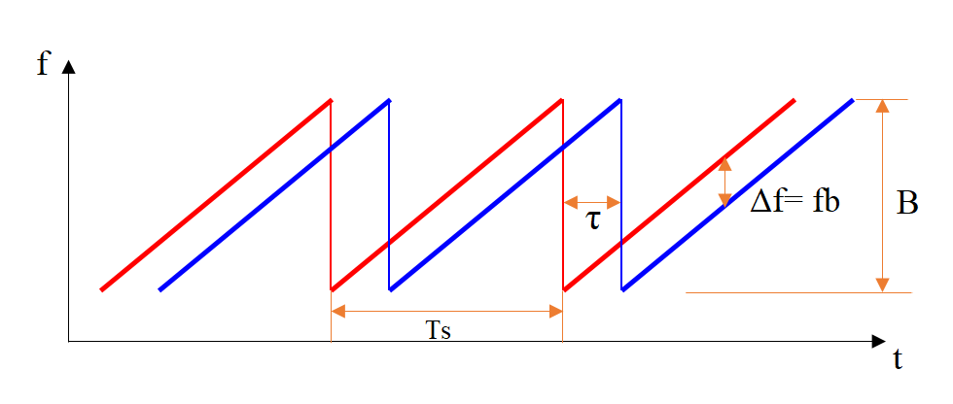
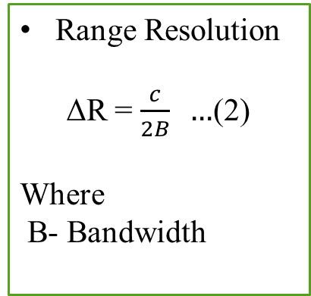
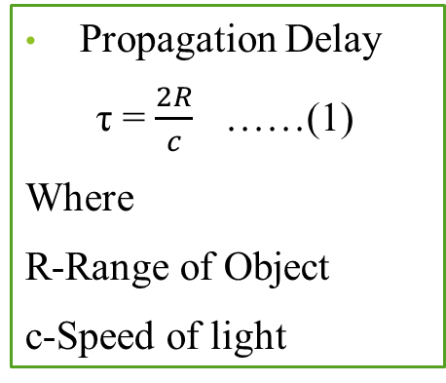
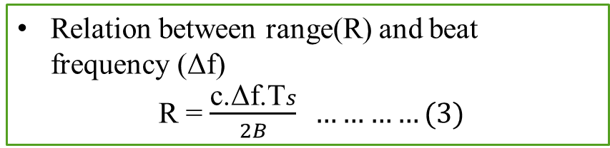
Mathematical Modelling
Propagation Delay
τ = $\frac{2R}{c}$ ……(1)
Where
R-Range of Object
c-Speed of light
Range Resolution
ΔR = $\frac{c}{2B} …$(2)
Where
B- Bandwidth
Relation between range(R) and beat frequency (Δf)
R = $\frac{\text{c}\text{.}\text{Δ}\text{f}\text{.}\text{T}s}{2B} …………(3)$
Fig.2.FMCW Radar chirp signal

Slide 7
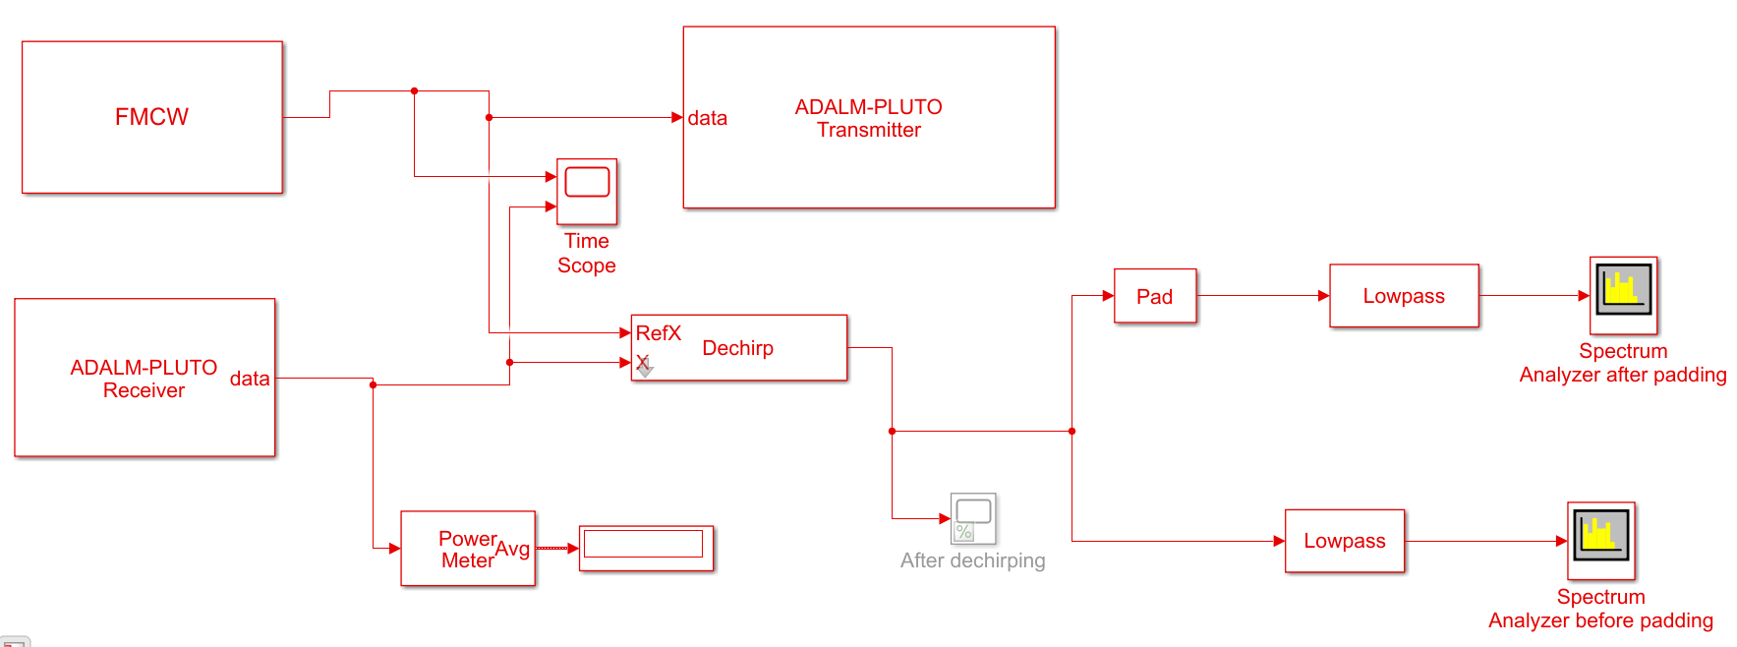
Simulink Setup
Fig.3.Block Diagram of FMCW Radar

Slide 8
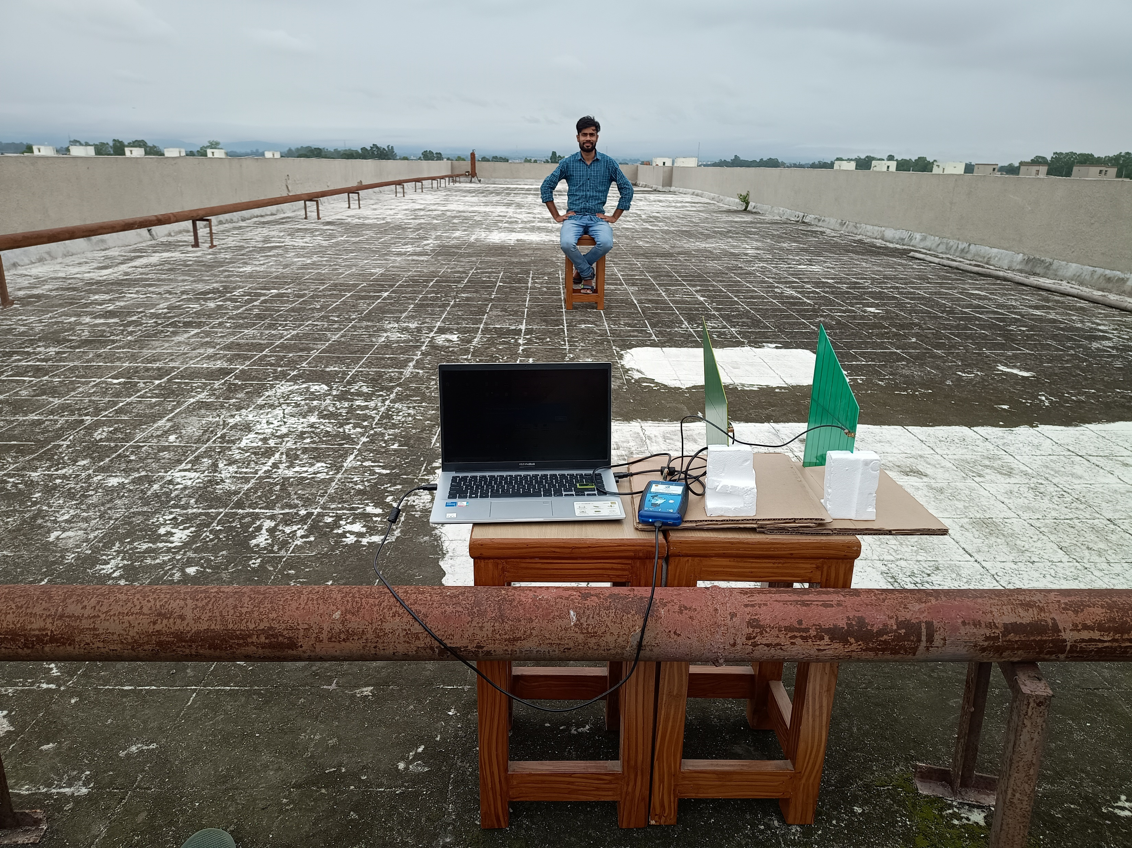
Test Setup
Fig.4.Setup at 4 meter distance from object

Slide 9
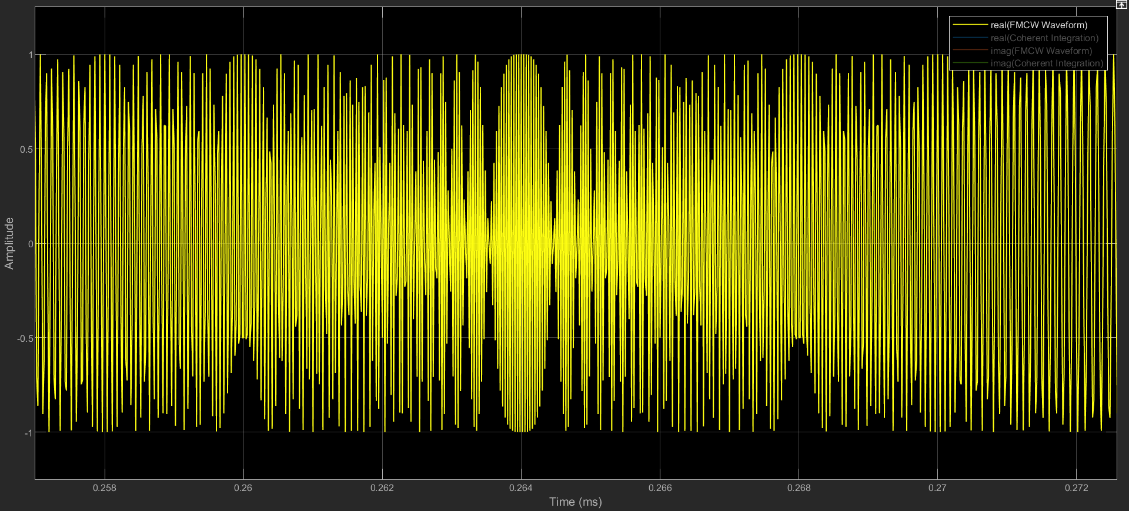
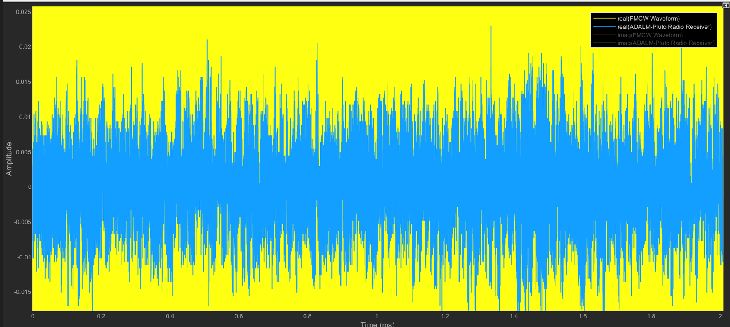
Simulated Results
Fig.5(a).Real Transmitted Waveform
Fig.5(b).Real Received Waveform

Slide 10
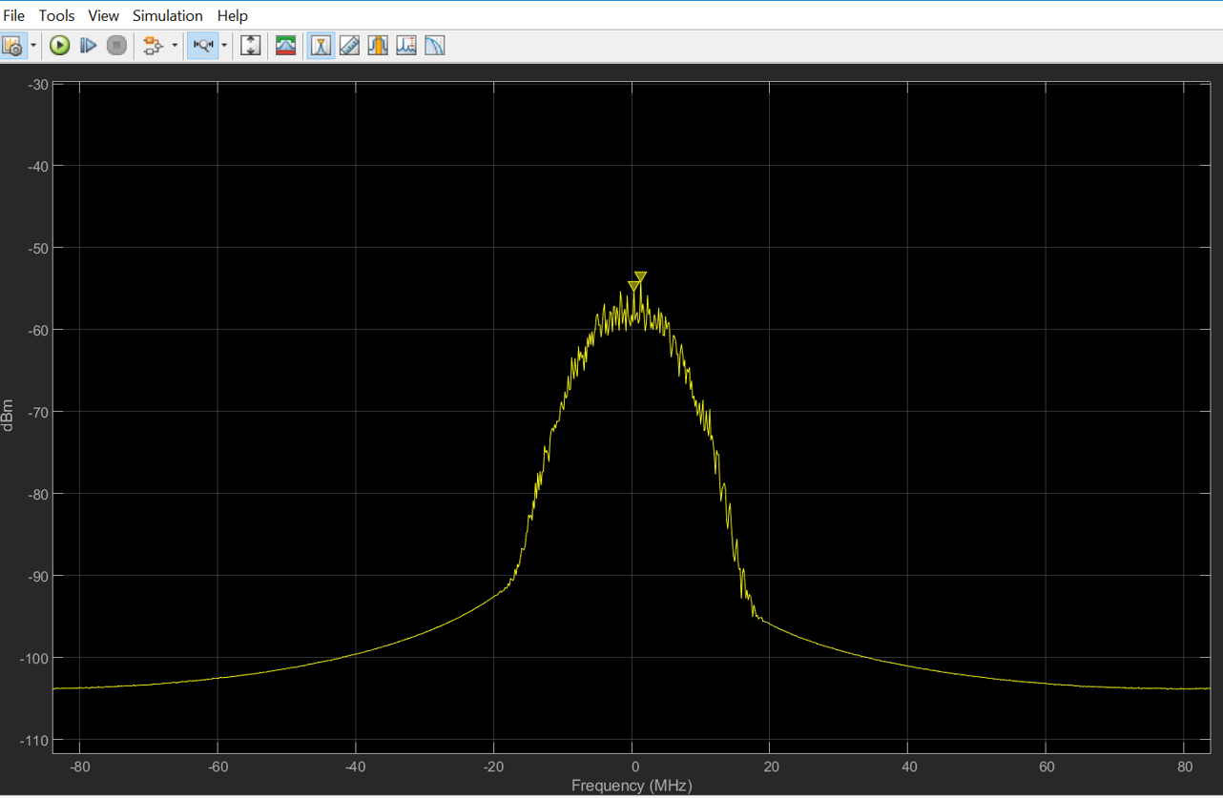
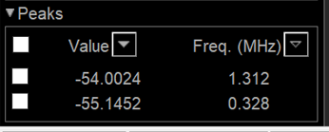
Simulated Results
Real time distance = 4m
Actual distance detected=3.5m
Fig.6.Real time beat Frequency detection by performing FFT on beat signal

Slide 11
Future Work Time line
October
We will try to observe the breathing pattern in a outdoor environment for a single person.
November
We will try to observe the breathing pattern in a indoor environment for a single person.
December onwards
We will try the same for the multiple person.

Slide 12
Conclusion
Till now we have approximately detected the range of a static object.
Range detection of a static object in indoor system is difficult to achieve due to multipath components.
To achieve high accuracy of range detection we have to use directional antenna.
Due to limited bandwidth of Adalm Pluto Radio(56MHz) , range resolution of FMCW radar will be less.

Slide 13


Slide 14
1.Try to detect the object if there is one more object is besides of your main object , and see what will be the effect on your signal. 2. Find the gain of used antennas and understand their concept. 3. Find the SNR and search about noise floor. 4. Why you are getting the so many peaks in your spectrum analyzer. 5. Take care of how much power you are transmitting and receiving .

